Slide 1

TARGET FOLDER
SRNTGT070
Notion Army 4th Corps HQ, SRN
SECRET - DCS WORLD
REL TO COALITION
SECRET - DCS WORLD
REL TO COALITION

Slide 2

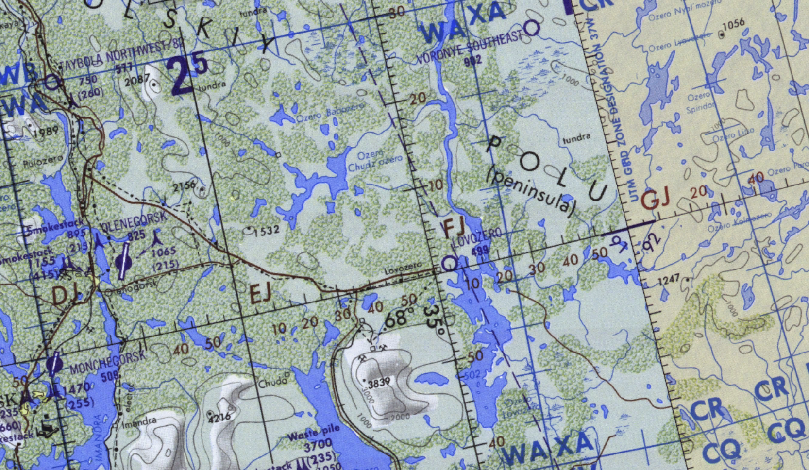
Notion Army 4th Corps HQ, SRN
OPAC CLASSIFIED REL TO CJTF-23
JOINT OPERATIONS GRAPHIC 1
MAP
OVERVIEW
BE: SRNTGT070 CATCODE: 2
MIDB GEO: N68 00.208 E038 01.060
ICOD: 2011-JUL-08 DOI:2011-JUL-08
DECL ON: 2061-JUL-08
N
Notion Army 4th Corps HQ SRNTGT070
.

Slide 3
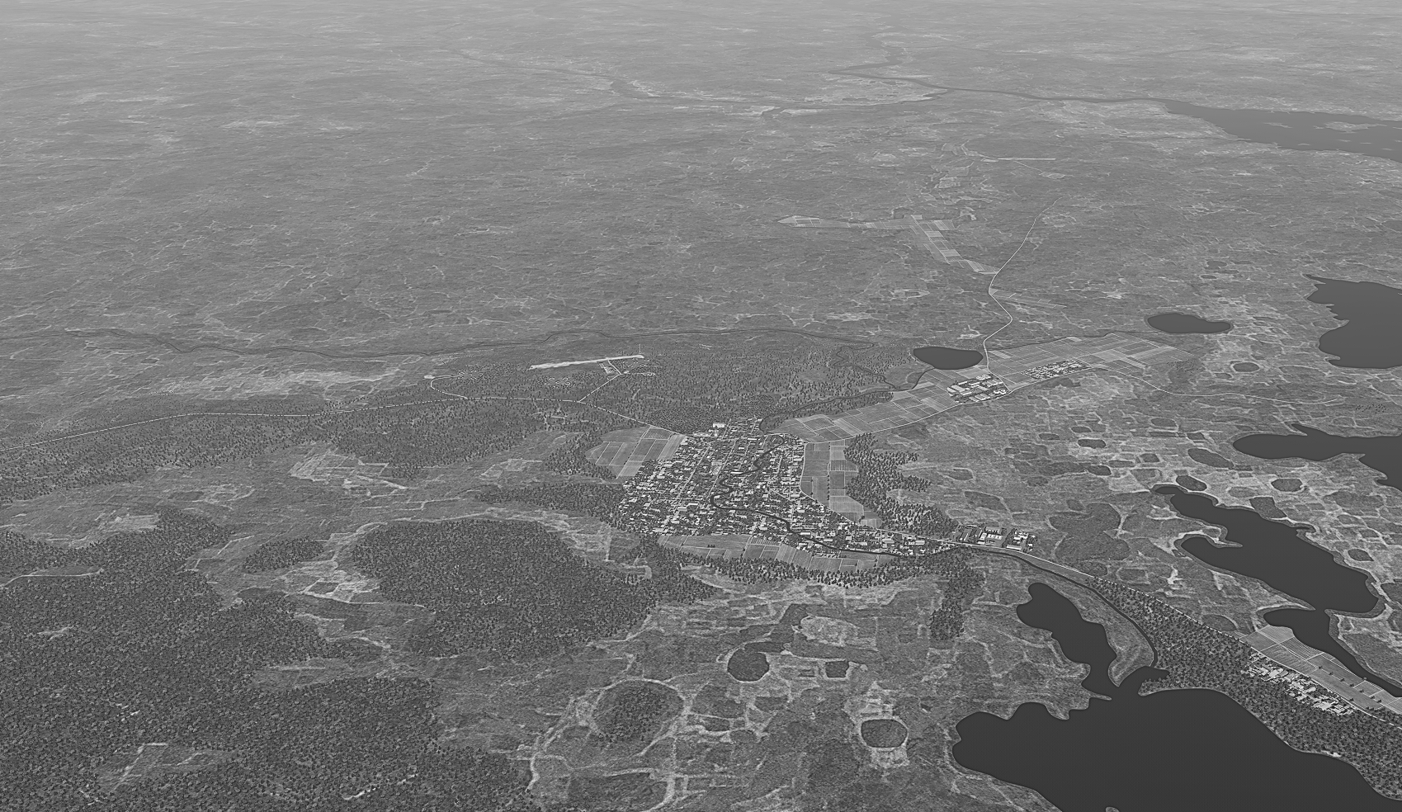
Notion Army 4th Corps HQ, SRN
OPAC CLASSIFIED REL TO CJTF-23
FACILITY OUTLINE GRAPHIC 1/1
MAP
OVERVIEW
BE: SRNTGT070 CATCODE: 2
MIDB GEO: N68 00.208 E038 01.060
ICOD: 2011-JUL-08 DOI:2011-JUL-08
DECL ON: 2061-JUL-08
N
Notian Army 4th Corps HQ SRNTGT070
Air Defence Academy SRNTGT026
Lovozero Laboratory SRNTGT017

Slide 4
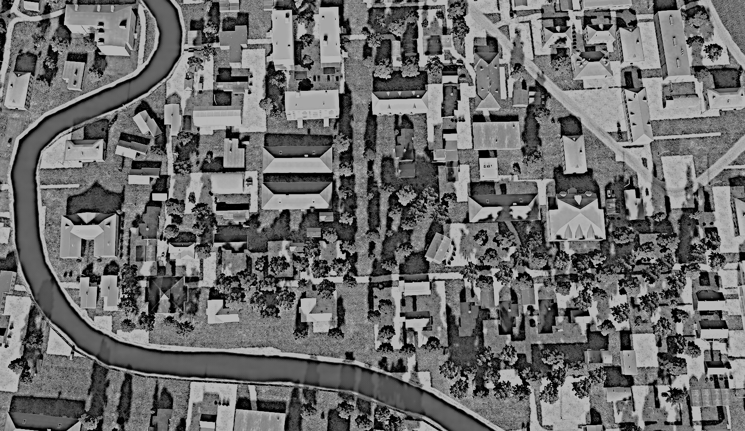
Notion Army 4th Corps HQ, SRN
OPAC CLASSIFIED REL TO CJTF-23
DESIRED POINT OF IMPACT GRAPHIC 1/1
MAP
OVERVIEW
BE: SRNTGT070 CATCODE: 2
MIDB GEO: N68 00.208 E038 01.060
ICOD: 2011-JUL-08 DOI:2009-JUN-18
DECL ON: 2061-JUL-08
N
DPI: C
DPI: B
DPI: A
DPI: SRNTGT070-A
LEADERSHIP BUIDLING
N68 00.200 E038 00.883
DPI MSL: 513 FT
DPI: SRNTGT070-B
CURRENT OPERATIONS BUILDING
N68 00.212 E038 01.252
DPI MSL: 512 FT
DPI: SRNTGT070-C
RADIO TOWER
N 68 00.217 E 035 01.000
DPI MSL: 512 FT

Slide 5
Notion Army 4th Corps HQ, SRN
OPAC CLASSIFIED REL TO CJTF-23
WEAPONEERING OPTIONS 1/1
MAP
OVERVIEW
BE: SRNTGT070 CATCODE: 2
MIDB GEO: N68 00.208 E038 01.060
ICOD: 2011-JUL-08 DOI:2011-JUL-08
DECL ON: 2061-JUL-08
DPI | DESCRIPTION | TLE | WARHEAD | GUIDANCE | DESIRED EFFECT | IMPACT ANGLE | FUZING
DPI A | MS BUILDING REINFORCED BUILDING | 3 | 1000IBS | DECIMETRIC | BLAST | 60˚ - 90˚ | 25ms
DPI B | MS BUILDING | 3 | 1000LBS | DECIMETRIC | BLAST | 60˚ - 90˚ | 25ms
DPI C | RADIO MASK AND SHED | 3 | 500LBS | METRIC | BLAST | 60˚ - 90˚ | 25ms

Slide 6
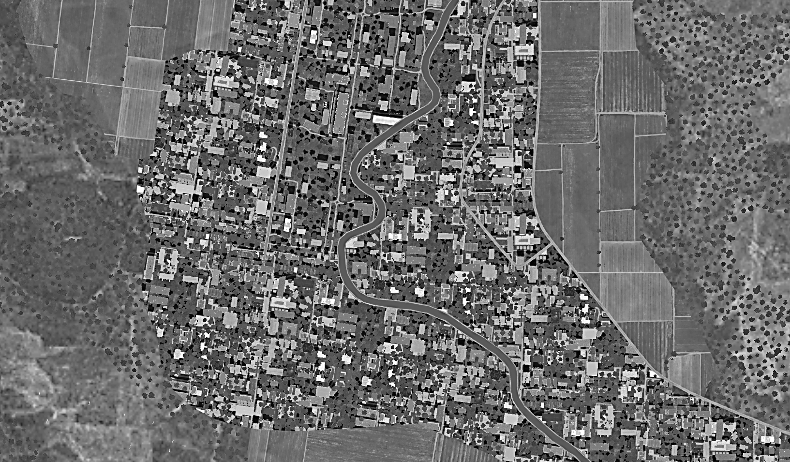
Notion Army 4th Corps HQ, SRN
OPAC CLASSIFIED REL TO CJTF-23
COLLATERAL DAMAGE ESTIMATION GRAPHIC 1/1
MAP
OVERVIEW
BE: SRNTGT070 CATCODE: 2
MIDB GEO: N68 00.208 E038 01.060
ICOD: 2011-JUL-08 DOI:2011-JUL-08
DECL ON: 2061-JUL-08
N
CER 250M
RESEDENTIAL AREA
WITHIN 30m of TARGETS
DPI: B
DPI: A
CDE3, PGM

Slide 7
Notion Army 4th Corps HQ, SRN
OPAC CLASSIFIED REL TO CJTF-23
COLLATERAL DAMAGES ESTIMATION 1/1
MAP
OVERVIEW
BE: SRNTGT070 CATCODE: 2
MIDB GEO: N68 00.208 E038 01.060
ICOD: 2011-JUL-08 DOI:2011-JUL-08
DECL ON: 2061-JUL-08
COLLATERAL DAMAGES WITHIN A 500M RADIUS
DESCRIPTION |  | CATCODE | MIDB GEOS | LOCATION | REMARKS
CIVILIAN RESEDENTIAL BUILDINGS |  | 14 |  | <100m from Any DPI | Potential Civilian Casualties
NO STRIKE ENTITIES WITHIN A 500M RADIUS
NSE ID | DESCRIPTION | CATCODE | MIDB GEOS | LOCATION | REMARKS
 | N/A

Slide 8
Notion Army 4th Corps HQ, SRN
OPAC CLASSIFIED REL TO CJTF-23
BATTLE DAMAGE ASSESSMENT GRAPHIC [X]
MAP
OVERVIEW
BE: SRNTGT070 CATCODE: 2
MIDB GEO: N68 00.208 E038 01.060
ICOD: 2011-JUL-08 DOI:2011-JUL-08
DECL ON: 2061-JUL-08
POST-STRIKE
PRE-STRIKE
N
TARGET OBJECTIVE
DAMAGE/CHANGE ASSESSMENT
DPI:[XXXXXX]
BDA REMARK: [CLASSIFICATION] [DISSEMINATION] Assessment: Physical Damage/change, Collateral Damage, Functional Damage/change, Munitions Effectiveness, Reattack Recommendation, Additional/Collateral Effects

Slide 9

ACRONYMS
ACRONYM | MEANING | DEFINITION
BE | Basic Encyclopedia Number | Alpha/numeric code unique to an installation for incorporation within various national and tactical systems.
CATCODE | Category Code | The data Element that classifies the function and purpose of an installation or a facility.
MIDB | Modernized Integrated Database | A database comprised of information on facilities of military significance, military forces, and related equipment.
ICOD | Intelligence Cut Off Date | The date of the latest intelligence data inputted to a feature.
DOI | Date of Image | Date on which a geospatial or intelligence-related image was captured.
CE | Critical Element | An element of an entity or object that enables it to perform its primary function.
PV CHAR | Physical Vulnerability Characteristic | Standardized alphanumeric code describing the physical and structural properties of a target.
DPI | Joint Desired Point of Impact | A unique, alphanumeric coded aimpoint identified by a three dimensional mensurated point. It represents a weapon or capability desired point of impact or penetration.
CE90 | Circular Error at 90% | 90 percent confidence level in the horizontal plane.
LE90 | Linear Error at 90% | 90 percent confidence level in the vertical dimension
MSL | Mean Sea Level | Elevation above Earth reference geoid.
AGL | Above Ground Level | Elevation above ground surface.
NCC | Nearest Collateral Concern | Closest non-targeted structure, area, or entity near a planned point of impact that may be at risk of unintended damage during a military strike.
CER | Collateral effects radius | Radius within which collateral damage might happen based on the weapon's characteristics, the target environment, and other operational factors.
CDE | Collateral damage estimate | Systematic process used in military targeting to evaluate the potential for unintended damage or harm to non-combatant entities, structures, or personnel as a result of a planned strike.
NSE | No Strike Element | Specific entities, locations, or objects that are protected from intentional targeting under the Law of Armed Conflict (LOAC) or by operational policy.

